Slide 1
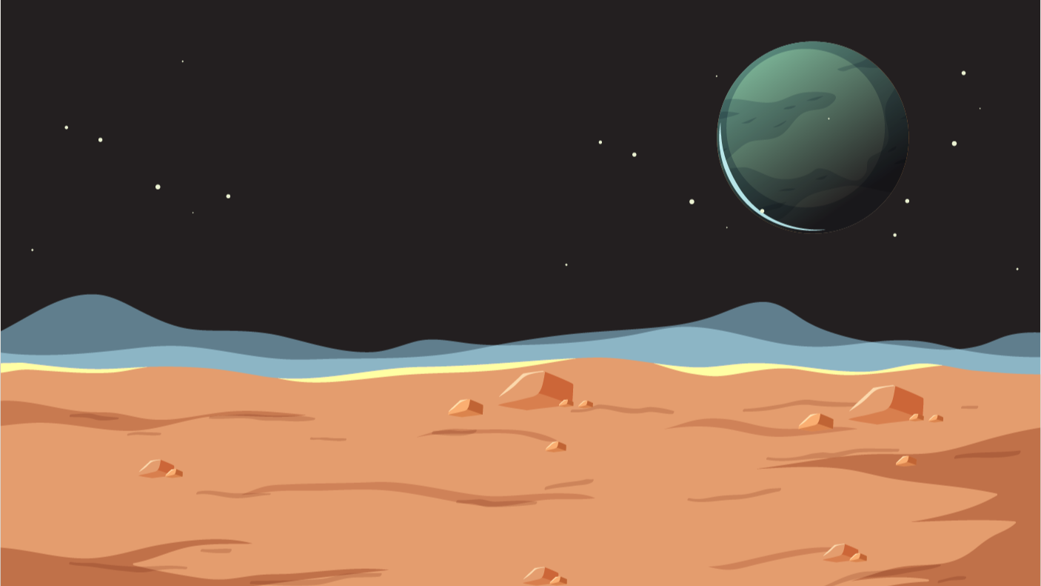

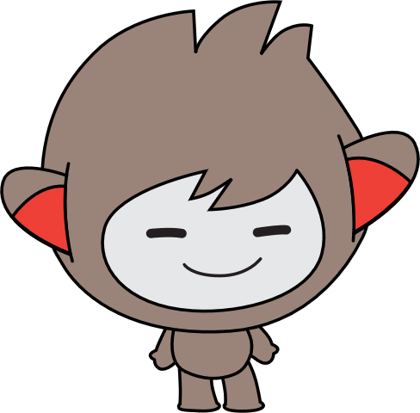


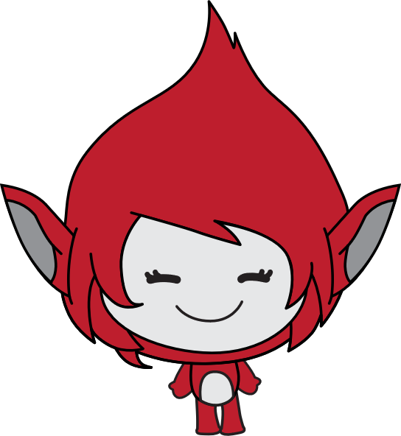


Lesson 1:
space talk

Slide 2
You will Create…
…a space scene with three aliens communicating to each other

Slide 3
Lesson 1:
space talk

